Slide 1



Slide 2


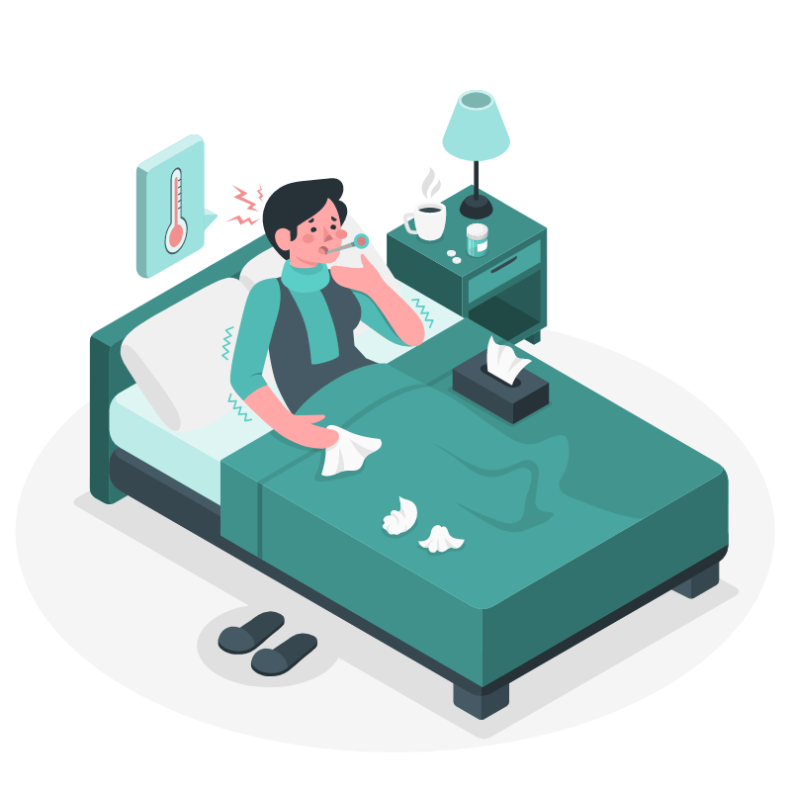
CONSIDER:
YOU CAUGHT A COUGH TODAY
Would you get it checked right away?
Notes:
We’re sure you know of someone who's having mysterious yet mild symptoms but can’t or won’t get checked up. Say they’ve caught a cough.
Is a checkup worth the costs?
Worth the ridiculous wait times?
Worth the risk of catching something worse?

Slide 3

THIS HAS BEEN THE REALITY OF MILLIONS
Notes:
In the age of a pandemic, limited access to healthcare is our current reality. But it has been the reality of tens of millions before COVID-19, and it will continue to be their reality after.

Slide 4



0 1 2 3
0 2 4 6 80 2 4 6 8
0 2 4
6
.
MILLION DEATHS
Notes:
Globally, the lack of healthcare accessibility costs us not only 3.6 million deaths a year,…

Slide 5

0 1 2 3 4
0 2 4 6 80 2 4 6 8
0 2 4 6 80 2 4 5
0 2 4 6 80 2 4 6 8
0 2 4 6 80 2 4 6 8
0
$
BILLION
Notes:
…but also $450 billion dollars too—costs that can be avoided if everybody could simply get a checkup when they need it.

Slide 6

Notes:
Introducing: Apollo, Your Digital Nurse

Slide 7


HI! I’M APOLLO.
How are you feeling today?
Notes:
While we can’t save everyone, we can help the 67% that owns a smartphone.
Meet Apollo: our solution to this healthcare crisis, and your virtual nurse.

Slide 8



APOLLO CAN:
LISTEN
DOCUMENT
CATEGORIZE
Notes:
Apollo provides an intuitive interface that listens, documents and categorizes your symptoms from interactive virtual appointments. Based on these symptom logs, Apollo can then suggest possible diagnoses and schedule appointments with a medical professional if necessary.

Slide 9



ACCESSIBLE
INTERACTIVE
PROACTIVE
Notes:
Apollo achieves to mends this gap in healthcare by being:
More accessible than traditional healthcare;
More interactive than competing symptom trackers;
And a more proactive healthcare solution than mainstream telehealth.

Slide 10


